Slide 1
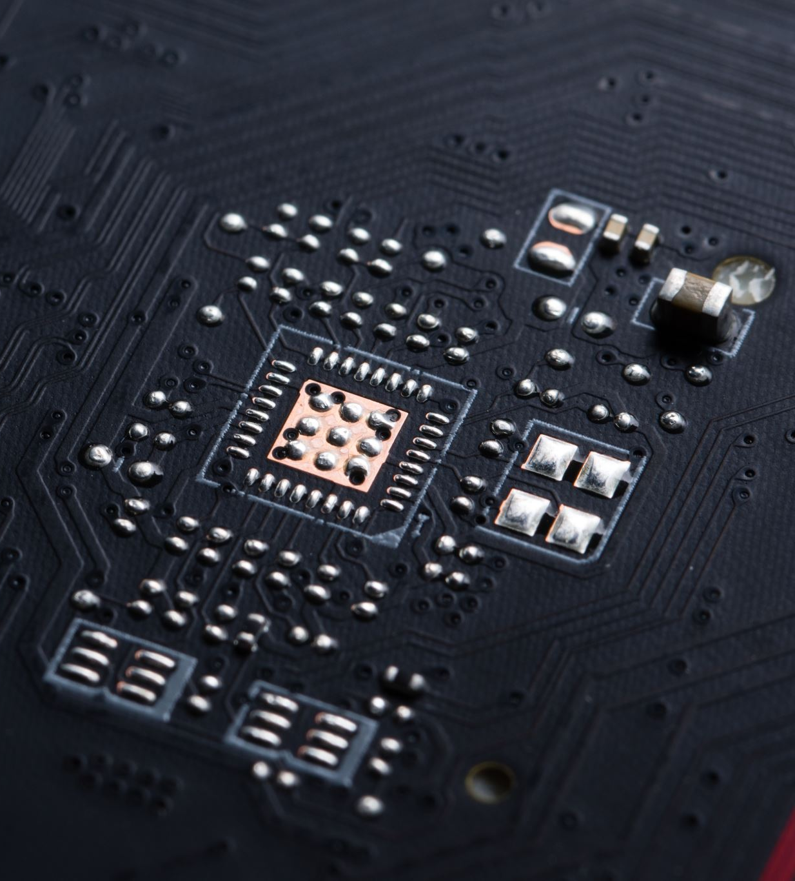

Looking at Computers: Understanding the Parts

Slide 2
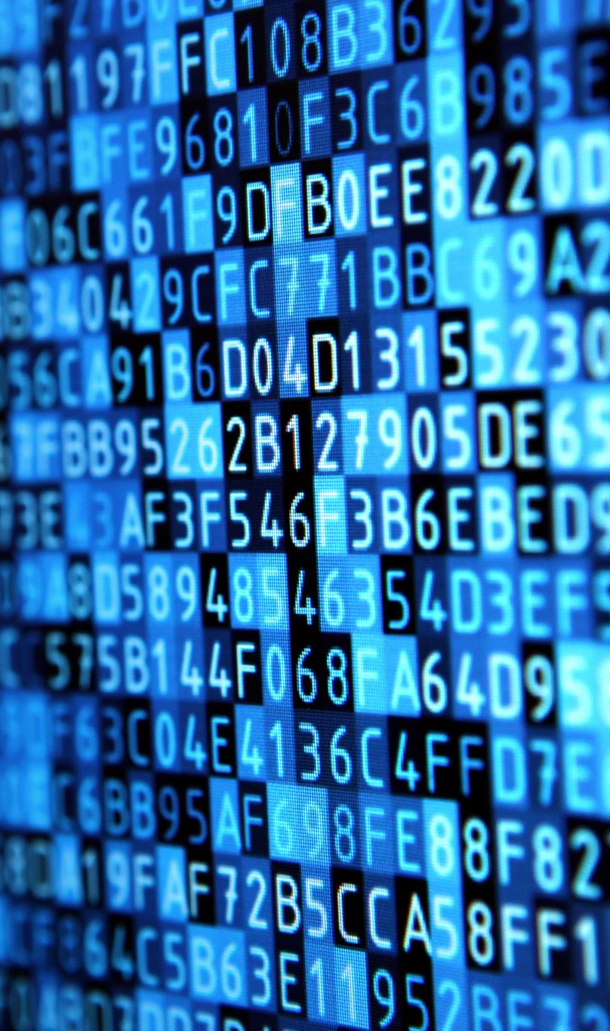
Learning Objectives
Describe the four main functions of a computer system and how they interact with data and information.
Define bits and bytes, and describe how they are measured, used, and processed.
List common types of computers and discuss their main features.
Identify the main types of Input / Output devices.
Describe the various means of storing data and information with computing devices.
Describe common types of ports used today.
Define ergonomics and discuss the ideal physical setup for using computing devices.
Notes:
Slide 2 is a partial list of textbook Learning Objectives numbers and statements.

Slide 3
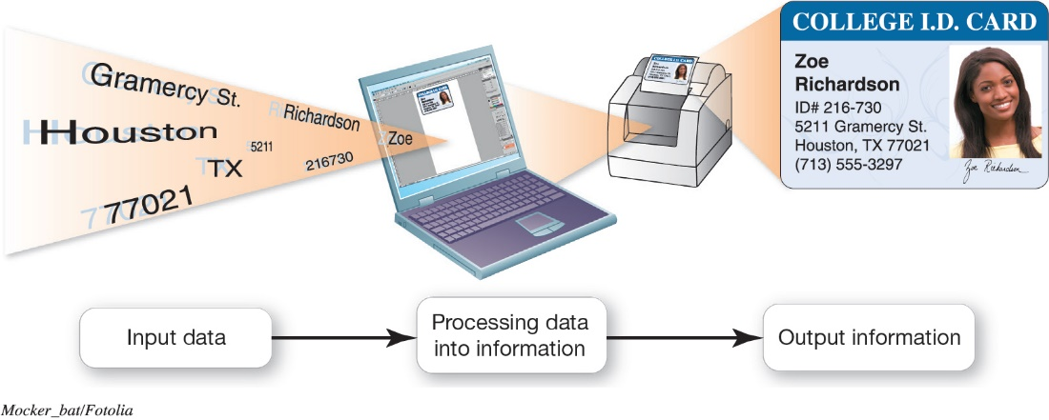
Understanding Your Computer Computers are Data Processing Devices
Perform four major functions
Input: Gathers data, allows entering data
Processing: Manipulates, calculates, or organizes data
Output: Displays data and information
Storage: Saves data and information
Notes:
4
Strictly defined, a computer is a data processing device that performs four major functions:
1. Input: It gathers data, or allows users to enter data.
2. Processing: It manipulates, calculates, or organizes that data into information.
3. Output: It displays data and information in a form suitable for the user.
4. Storage: It saves data and information for later use.

Slide 4
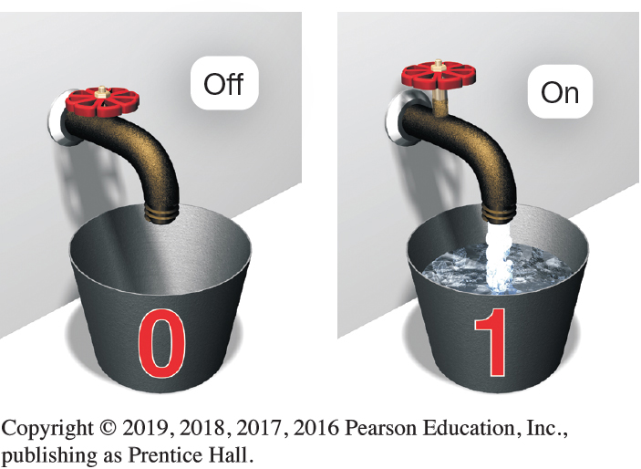
Understanding Your Computer Binary: The Language of Computers
Bit
Binary digit
0 or 1
Byte
Unique combinations of 8 bits of 0s and 1s
Kilobytes, megabytes, gigabytes, terabytes, and petabytes
Notes:
6
Computers need a language they understand. Binary language, consists of two digits: 0 and 1.
Each 0 and 1 is a binary digit, or bit for short. Eight binary digits (or bits) combine to create one byte.
In computers, each letter, number, and special character consists of a unique combination of eight bits.
Files can be quite large, containing thousands or millions of bytes.

Slide 5
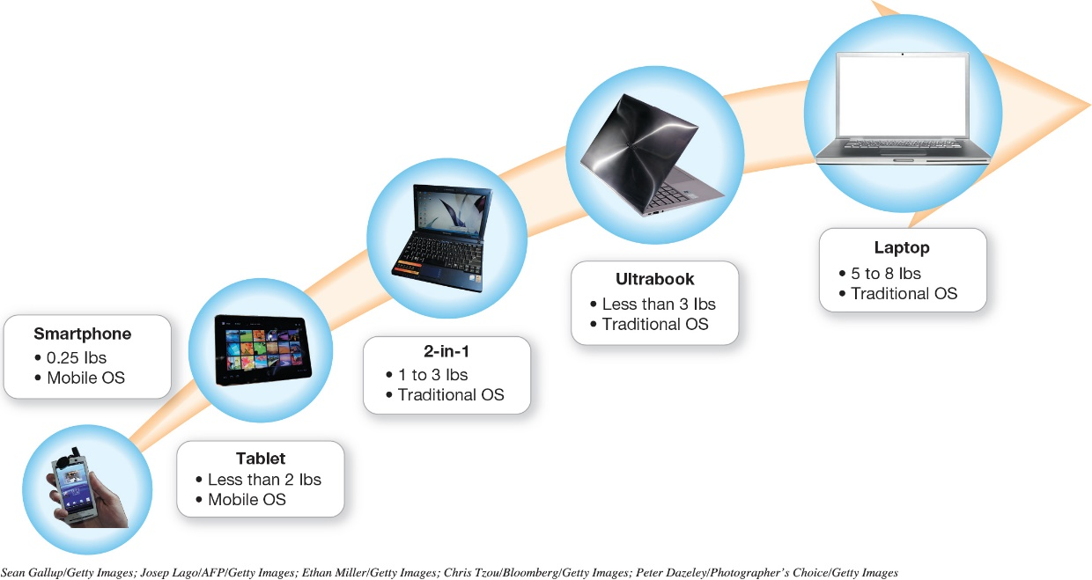
Understanding Your Computer Types of Computers
Cell phones
Tablets
Laptops and their variants
Choosing a portable device
Stationary computers
Notes:
8
Types of Computers include:
Cell phones
Tablets
Laptops and their variants
Choosing a portable device
Stationary computers

Slide 6
Input Devices Physical Keyboards and Touch Screens
Used to enter data and instructions
Examples
Keyboard
Touch screen
Stylus
Virtual keyboard
Mouse
Touch pad (trackpad)
Game controllers
Notes:
12
An input device enables you to enter data and instructions into your computer. Examples include:
Keyboard
Touch screen
Stylus
Virtual keyboard

Slide 7
Input Devices Image, Sound, and Sensor Input
Popular for images
Digital cameras
Camcorders
Mobil device cameras
Flatbed scanners
Webcams
Popular for sound
Microphone with voice recognition software
Sensors
Notes:
12
Popular input devices for images include:
Digital cameras
Camcorders
Mobil device cameras
Flatbed scanners
Webcams
Popular input devices for sound are:
Microphone with voice recognition software
Various sensors are also used to detect or measure things

Slide 8
Output Devices Image and Audio Output
Send data out of the computer in the form of:
Text
Pictures
Sounds
Video
Examples
Monitors
Printers
Speakers and earphones
Notes:
23
An output device lets you send processed data out of your computer in the form of text, pictures, sounds, or video.
The most common output device is a monitor, which displays text, graphics, and video as soft copies (copies you can see only on-screen).
Another common output device is a printer, which creates hard copies— copies you can touch—of text and graphics.
Speakers and earphones (or earbuds) are the output devices for sound.

Slide 9
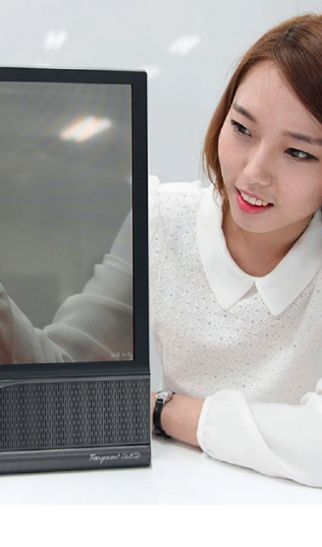
Output Devices Image and Audio Output
Jargons for display
Pixels – Picture Element
Aspect ratio 4:3 16:9
Resolution -
Types of display screens
Liquid crystal display (LCD) – Use liquid crystals to form image using backlight or reflector
Light-emitting diode (LED) – Uses array of light emitting diodes as pixels to display
Organic light-emitting diode (OLED) – Type of LED that uses emissive electroluminescent layer (a thin film of organics compound) that emits light in response to electric current
Active-matrix organic light-emitting diode (AMOLED) – Similar to OLED, but each pixel is attached to a transistor or capacitor to actively maintain pixel state
Notes:
23
The most common monitor is a liquid crystal display (LCD), also called a flat-panel monitor. It is light and energy-efficient.
Light-emitting diode (LED) technology is more energy-efficient and has better color accuracy and thinner panels than LCD monitors.
Organic light-emitting diode (OLED) displays use organic compounds that produce light when exposed to an electric current. Unlike LCDs and LEDs, OLEDs do not require a backlight and therefore draw less power and have a thinner display.
How they work:
Pixels refer to picture elements.
Aspect ratio is the relationship between the height and width of the screen.
Resolution is the amount of pixels that can be displayed.

Slide 10
Output Devices Image and Audio Output
Speaker
Output device for sound
Surround-sound speakers
Wireless speaker systems
Headphones or earbuds
Keep from distracting others
Notes:
Most computers include inexpensive speakers. These speakers are sufficient to play audio clips from the Web and enable you to participate in videoconferencing or phone calls made over the Internet.
A surround-sound speaker is a system of speakers and audio processing that envelops the listener in a 360-degree field of sound.
Wireless speaker systems are available to help you avoid cluttering up your rooms with speaker wires.
Headphones or earbuds plug into the same jack to which speakers connect. Hearing might be damaged by excessive volume when using earbuds.

Slide 11
Output Devices Printers
Inkjet
Affordable
High-quality color
Quick and quiet
Laser
Faster printing speed
Higher-quality printouts
More expensive
Cloud-ready printers
All-in-one printer
Printer, scanner, copier, and fax
Large format printer
Prints oversize images
3D printer
Notes:
30
Inkjet printers are affordable and produce high-quality color printouts quickly and quietly. They spray tiny drops of ink onto paper.
Laser printers use laser beams and static electricity to deliver toner onto the correct areas of the page. Heat fuses the toner to the page.

Slide 12
Processing and Memory on the Motherboard The Motherboard and Memory
Motherboard
CPU
ROM, RAM, and cache
Slots for expansion cards
Sound/Video cards
Network interface cards (NIC)
Notes:
42
The motherboard is located inside the system unit and contains the central electronic components of the computer, including the computer's processor (CPU), and many circuit boards that help the computer to function.
The motherboard includes slots for expansion cards, which provide additional functionality.
Sound cards connect speakers and a microphone. Video cards provide connections for the monitor.
Network interface cards enable your computer to connect with other computers and provide high-speed Internet connections.

Slide 13

Processing and Memory on the Motherboard Processing
Central Processing Unit
CPU or processor
“Brains” of the computer
Controls all functions of the computer’s components
Processes all commands and instructions
Gigahertz (Billions of tasks per second )
Notes:
43
The central processing unit (CPU, or processor) is sometimes referred to as the “brains” of the computer because it controls all the functions performed by the computer’s other components and processes all the commands issued to it by software instructions.
Current systems run at speeds measured in gigahertz or billions of machine cycles per second.

Slide 14

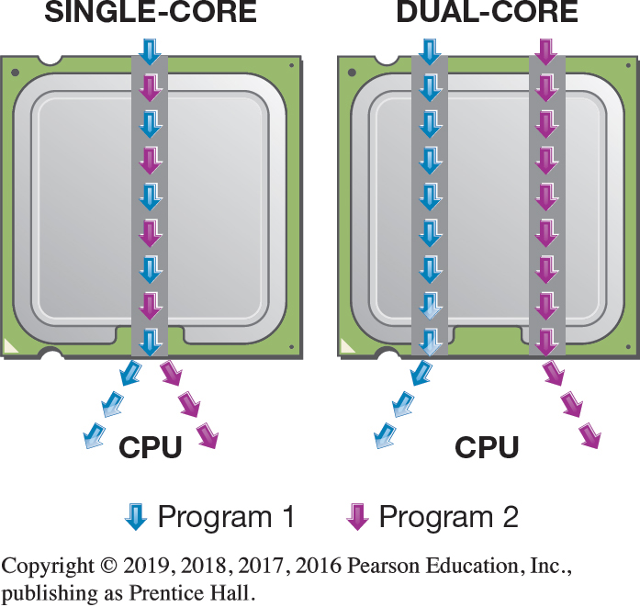
Processing and Memory on the Motherboard Processing
CPU Performance Measures
Processor speed measured in hertz (Hz)
Megahertz (MHz) or gigahertz (GHz)
Number of cores
Single
Dual
Quad
Ten
Notes:
43
Processor speed is measured in units of hertz. Hertz is a measurement of machine cycles per second.
Current systems run at speeds measured in gigahertz, or billions of machine cycles per second. Therefore, a 3.8 GHz processor performs at 3.8 billion machine cycles per second.
CPU performance is also affected by the number of cores, or processing paths, the processor has. Processors have been designed that have two, four, and even ten cores.

Slide 15

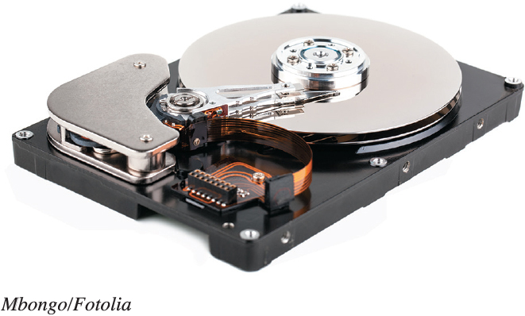
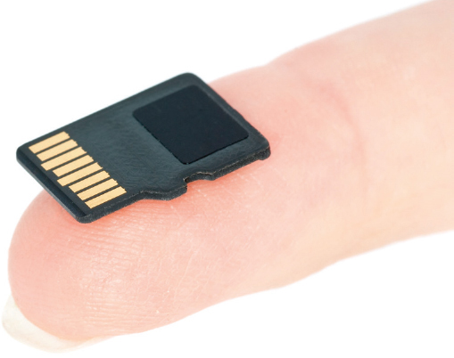
Storing Data and Information Storage Options on Computing Devices
Local Storage Devices
Hard disk drive
Primary storage device
Nonvolatile storage
Internal drive
External hard drive
Solid-state Drive (SSD)
Portable Storage Options
Flash drive
Flash memory card
Notes:
36
The hard disk drive is your computer’s primary device for permanent storage of software and documents.
Hard drives are nonvolatile storage devices.
An internal hard drive resides in the unit and holds all permanently stored programs and data.
External hard drives reside outside the unit and connect via a USB or FireWire port.
Solid-state drives have no moving parts, so they’re more efficient, run with no noise, emit little heat, and require little power.

Slide 16
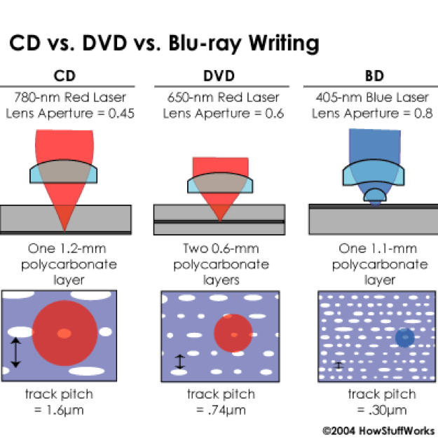
Storing Data and Information Storage Options on Computing Devices
Cloud storage
Files stored on the Internet
Some amount is free
Can purchase additional storage
Optical storage
Compact discs (CDs)
Digital video discs (DVDs)
Store more data than CDs
Blu-ray discs (BDs)
Notes:
36
Cloud storage refers to files being stored on the Internet.
Most companies offer a limited amount of space for free.
Additional space can be purchased.

Slide 17
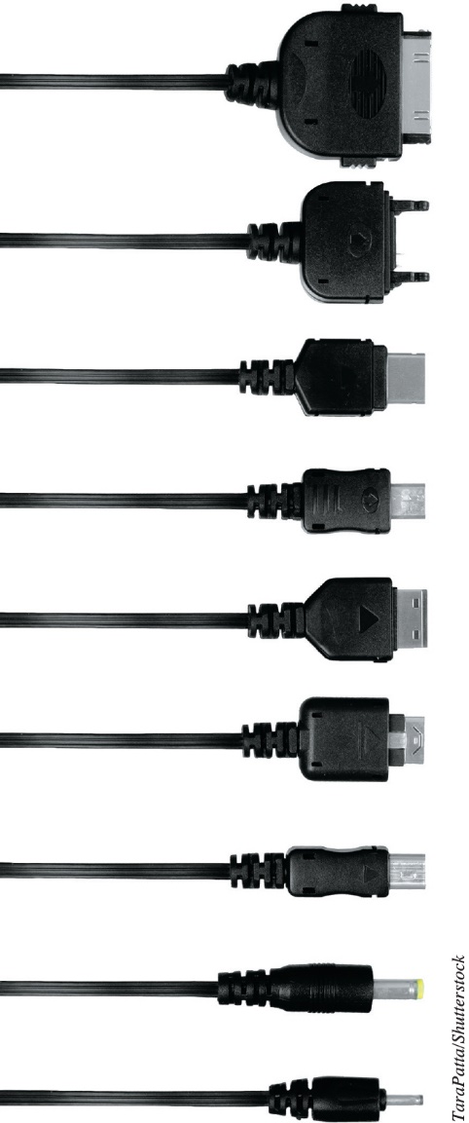
Connecting Peripherals to the Computer Computer Ports
Thunderbolt
Transfer speeds up to 20 Gbps
Universal serial bus (USB)
Transfer speeds of 10 Gbps
Connectivity port
Ethernet port
Up to 10,000 Mbps
HDMI port
Notes:
Thunderbolt provides a transfer rate of 20 Gbps.
Universal serial bus ports are used to connect input and output devices to computers.
The USB 3.1 standard provides transfer speeds of 10Gbps and charges devices faster than previous USB ports.
Connecting computers can be done through an Ethernet port.
HDMI ports are used for high definition audio and video.

Slide 18
Power Management and Ergonomics Power Controls and Power Management
Battery drain - For portable devices, it is important to know which devices drain the battery the most.
Power supply - The computer’s power supply provides power for the devices.
Sleep mode - In sleep mode, all documents in RAM stay in RAM when the computer is put to sleep.
Warm / Cold boot - When a computer is restarted it is called a warm boot. When the computer is started from a powered down state, it is referred to as a cold boot.
Hibernate - When a computer hibernates, it stores all the documents from RAM on the hard drive.
Notes:
46
For portable devices, it is important to know which devices drain the battery the most.
The computer’s power supply provides power for the devices.
In sleep mode, all documents in RAM stay in RAM when the computer is put to sleep.
When a computer is restarted it is called a warm boot. When the computer is started from a powered down state, it is referred to as a cold boot.
When a computer hibernates, it stores all the documents from RAM on the hard drive.

Slide 19

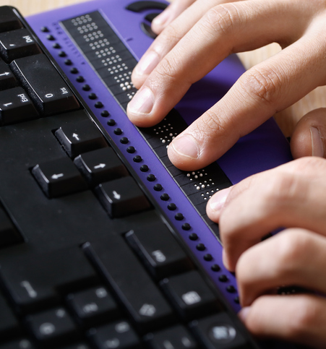
Power Management and Ergonomics Setting It All Up: Ergonomics
Ergonomics
Guidelines
Monitor position
Adjustable chair
Proper position while typing
Take breaks
Adequate lighting
Assistive (adaptive) technologies
Notes:
46
Ergonomics refers to how you set up your computer and other equipment to minimize your risk of injury or discomfort.
These guidelines can help keep you comfortable and productive:
Position your monitor correctly.
Purchase an adjustable chair.
Assume a proper position while typing.
Take breaks from computer tasks.
Ensure that the lighting is adequate.
Assistive (or adaptive) technologies are products, devices, equipment, or software that are used to maintain, increase, or improve the functional capabilities of individuals with disabilities.

Slide 20


